Slide 1
Java Chaperones
Robyn, Andrew, Alimaa and Adib
Notes:
Alimaa intro
HI EVERYONE, WE ARE THE JAVA CHAPERONES

Slide 2
Content
Introduction to our idea
Planning and organisation
Quick demo
Key code snippets
Future implementations
Key learning points

Slide 3
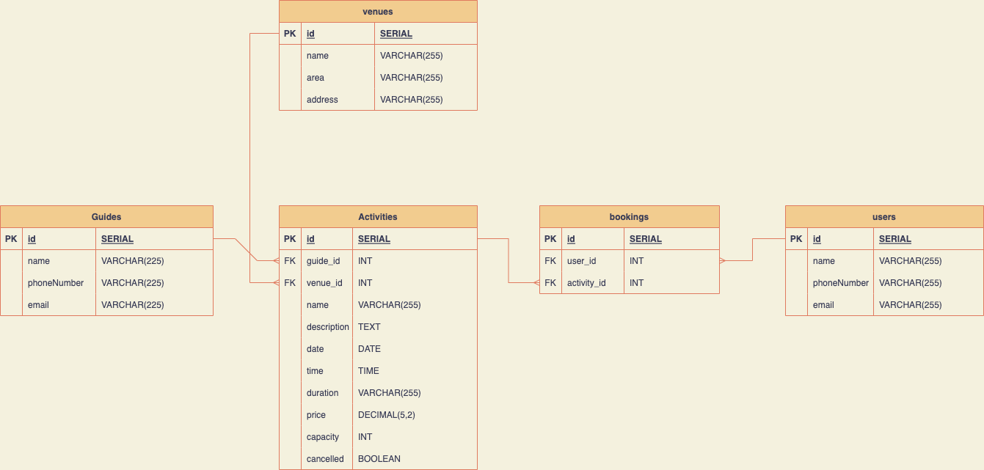
Our idea with visual representation
API to search, book, update and cancel activities and tours within different London locations for tourists and general adventure seekers.
Users can book an activity run by different guides.
Entity Relationship diagram

Slide 4
Planning and organisation
Tools used for planning
Entity Relations Diagram - via diagram.net
Excalidraw
Trello
Notes:
Adib
For us, planning and organisation of the project was key. We spent the majority of Friday planning and organising how to work. As you saw, we used a diagram app to demonstrate our entity relation diagram as well as as this we used excalidraw and trello to be more organised.

Slide 5
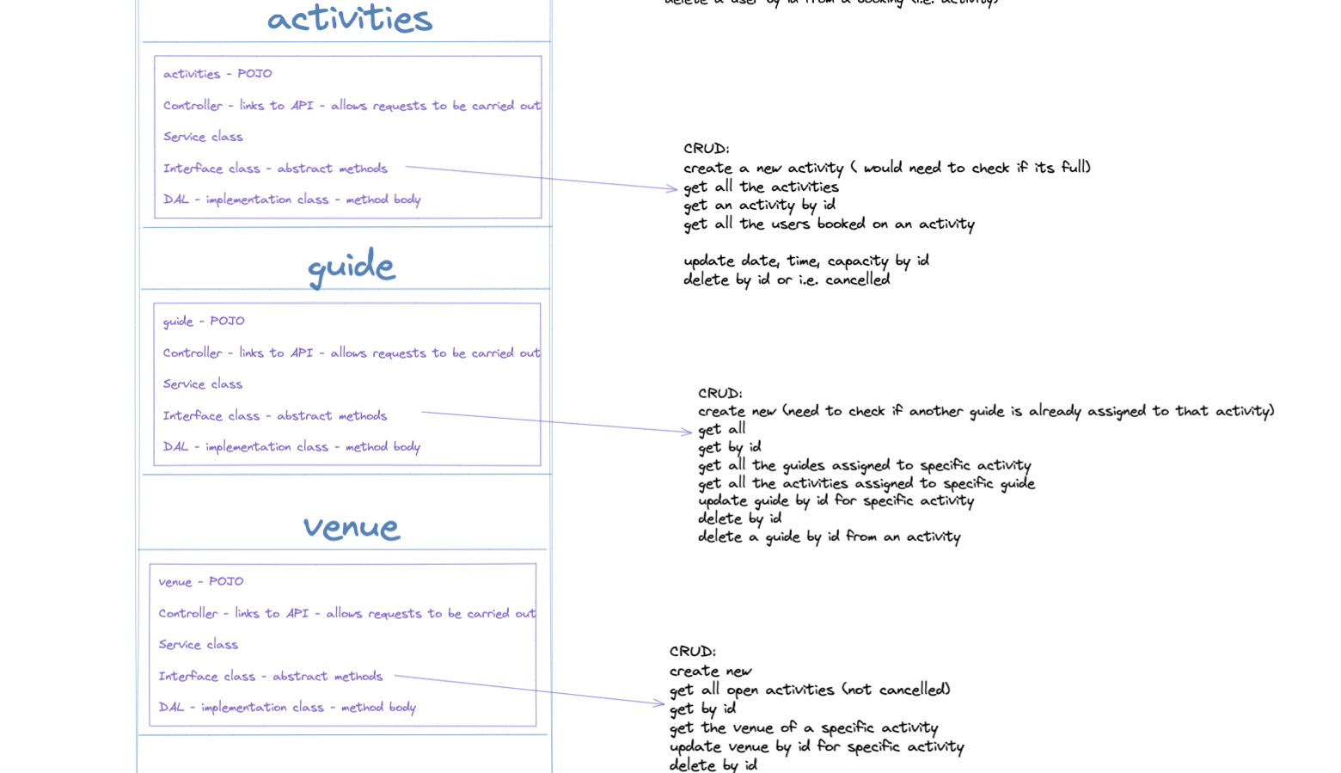
Excalidraw
Notes:
Adib
Excalidraw used to show all our POJO, packages and all our connections in between the api, DAO and other connections.

Slide 6
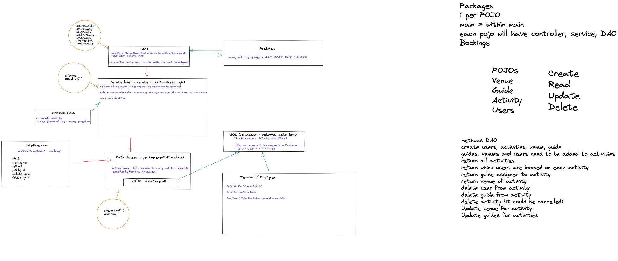
Excalidraw
Notes:
Adib

Slide 7
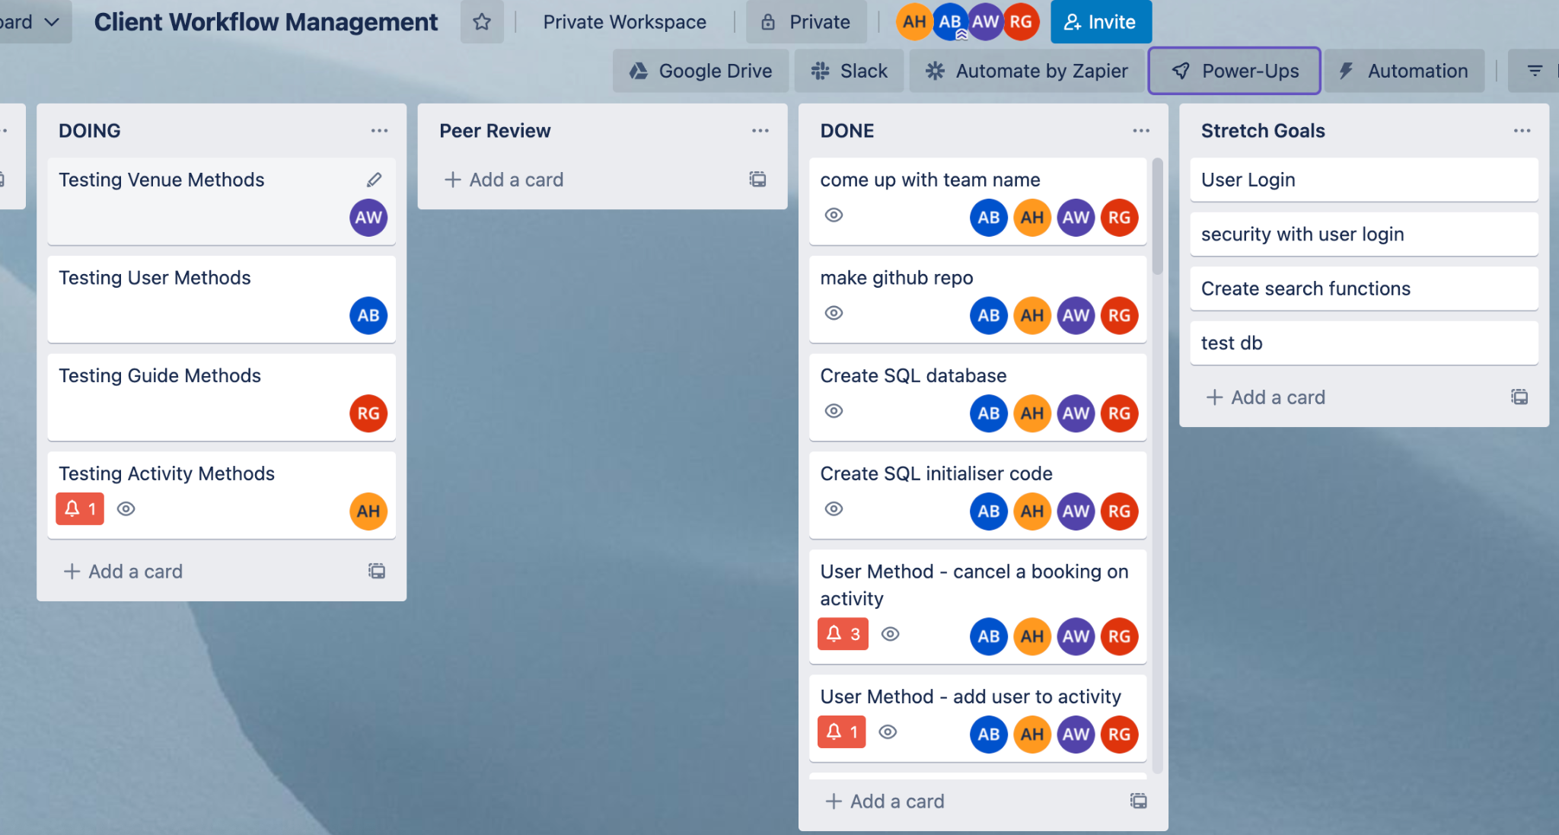
Trello
Notes:
Adib
Trello was used to keep on top of tasks, we all took a pojo each and started to work through the code. The most important part of this troll board is the peer review section. Sometimes seeing errors in your code is difficult and with peer review, it made it so the task could not be done without another person looking through it.
Before I pass over to Robyn and Andrew for some demos of our API on Postman, I just want to mention some of the tech we used throughout this project. For this project, we used java, springboot, Postgres, postman and Postico.

Slide 8
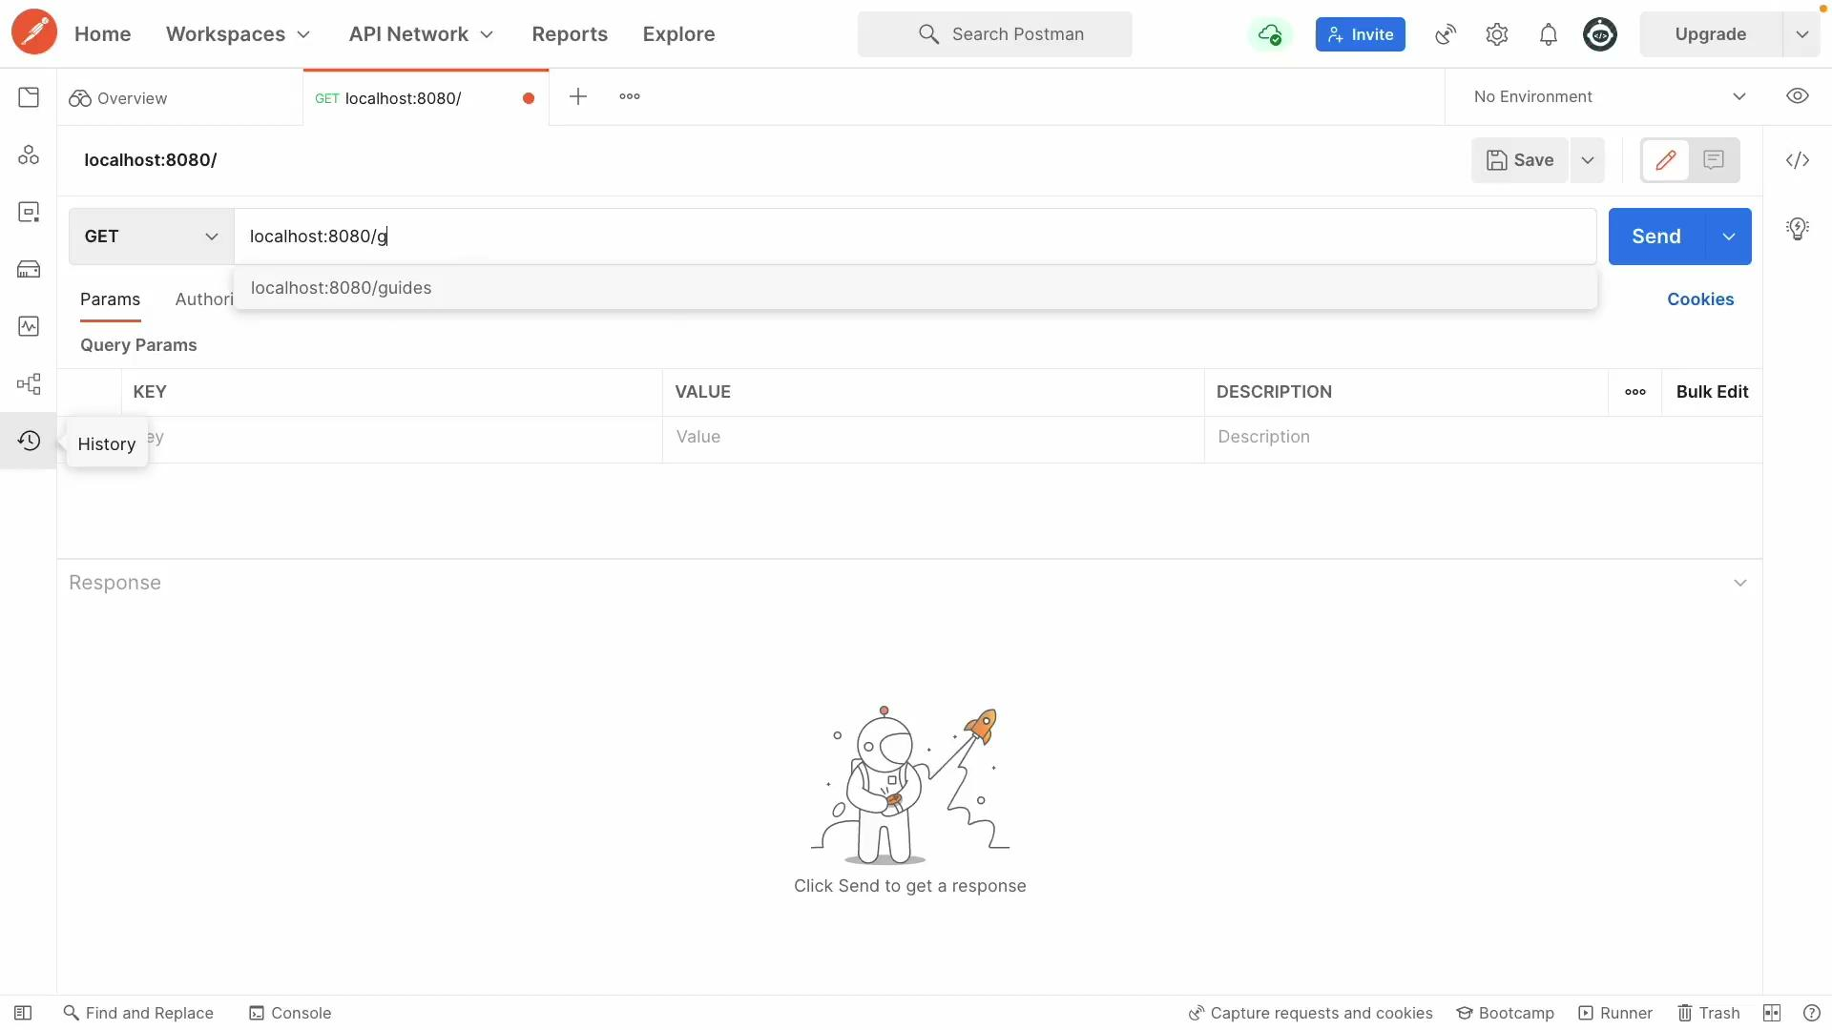
Notes:
Robyn demo
Clients can perform operations on entities:
Create
Read
Update
Delete

Slide 9
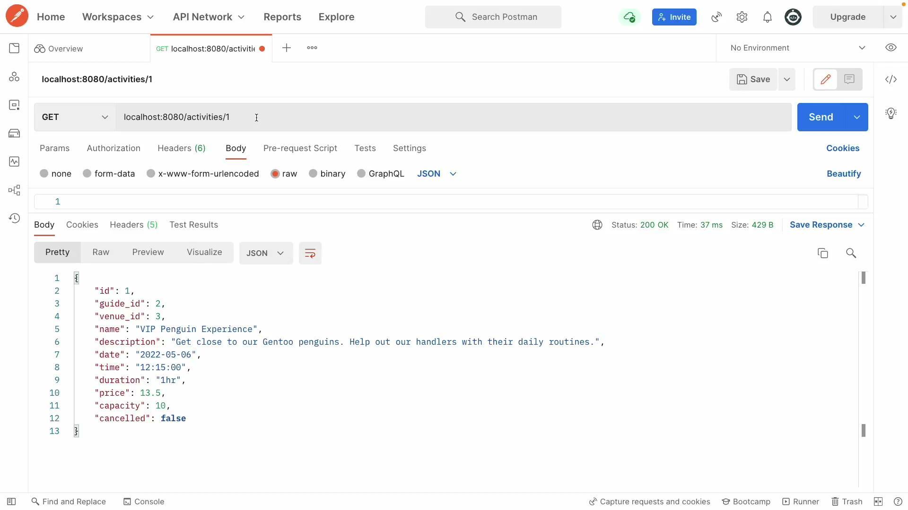
Notes:
Andrew demo:
Clients can manage bookings for users stored in the link table.
Activities can be quickly interrogated and cancelled from the path.

Slide 10
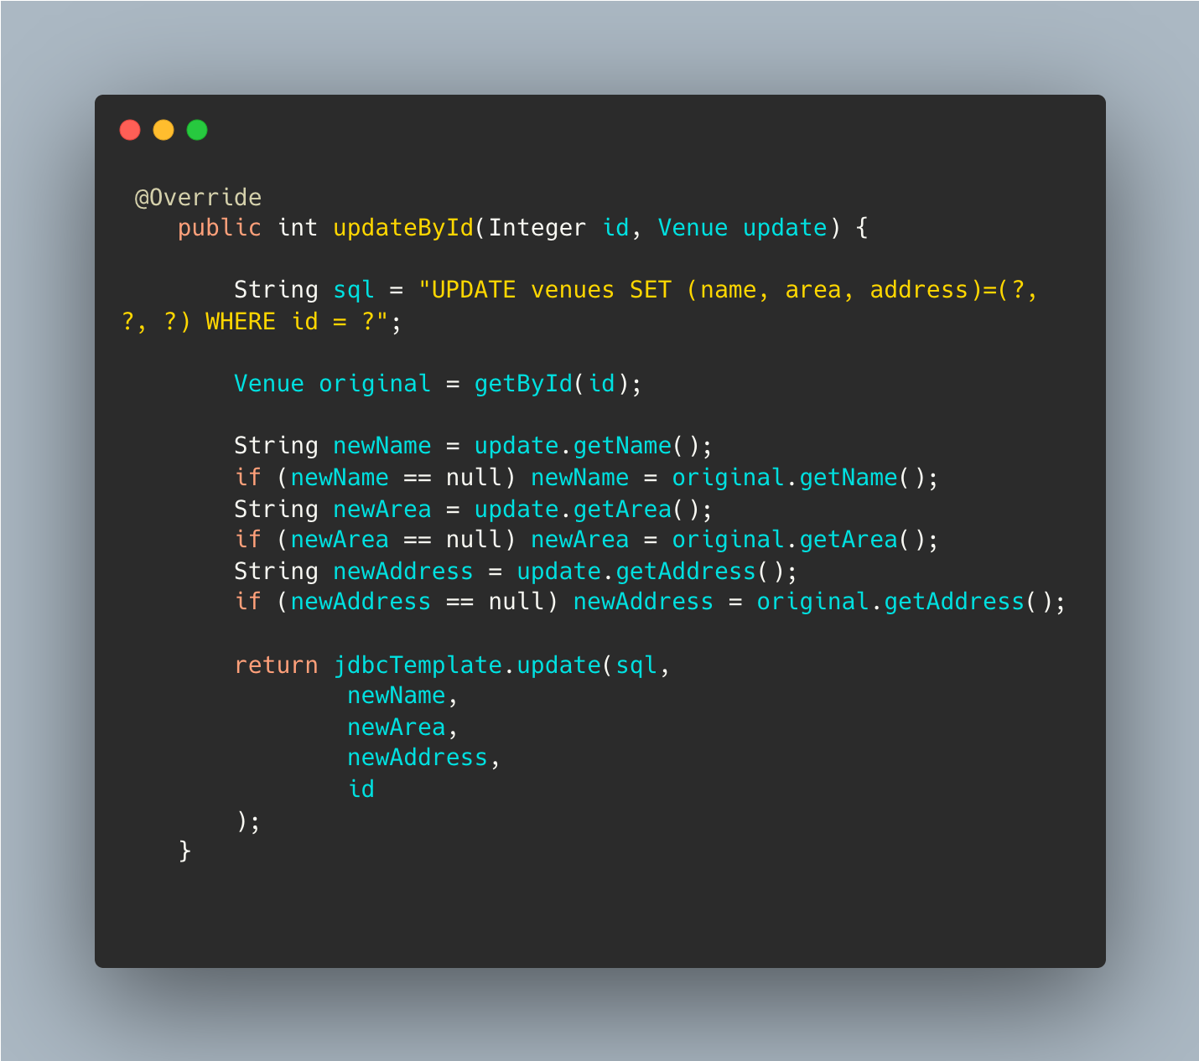
Code snippet
Updating an entity is simpler. Any fields not given in the JSON (null values) will be given the original values and not change.
Notes:
Andrew: updating required all to be populated
Missing fields would update the entity with null fields. BAD.
Code checks for null fields and uses original values for the update.
Updates are now simpler and more intuitive.

Slide 11
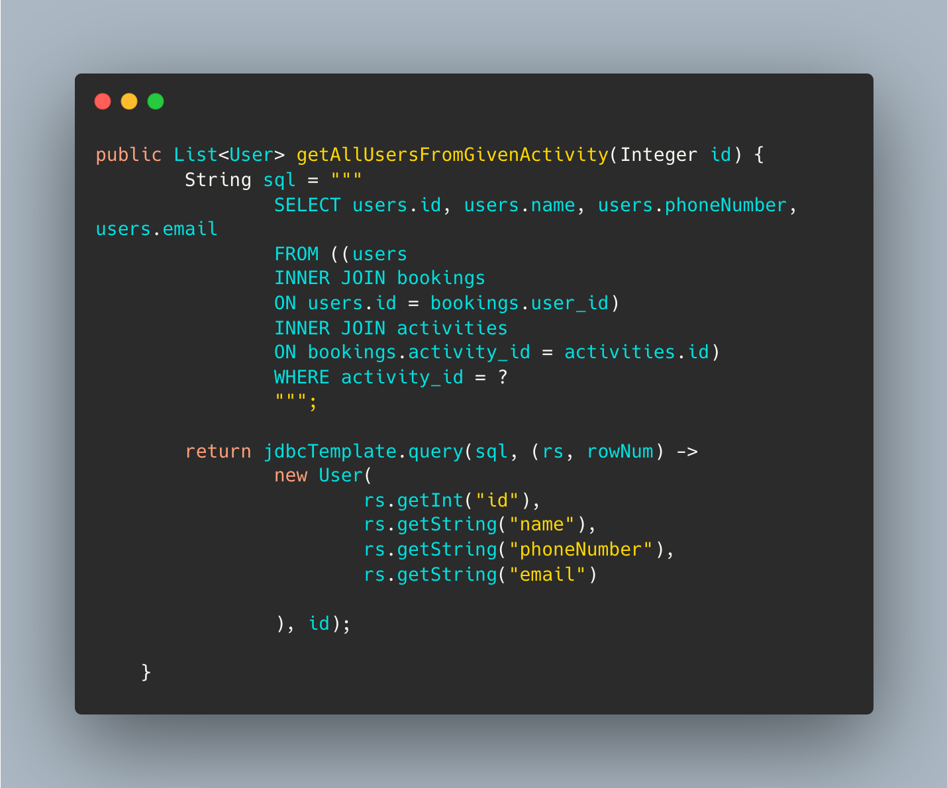
Code snippet
Get all the users booked onto an activity. This method required the use of a join table.

Slide 12
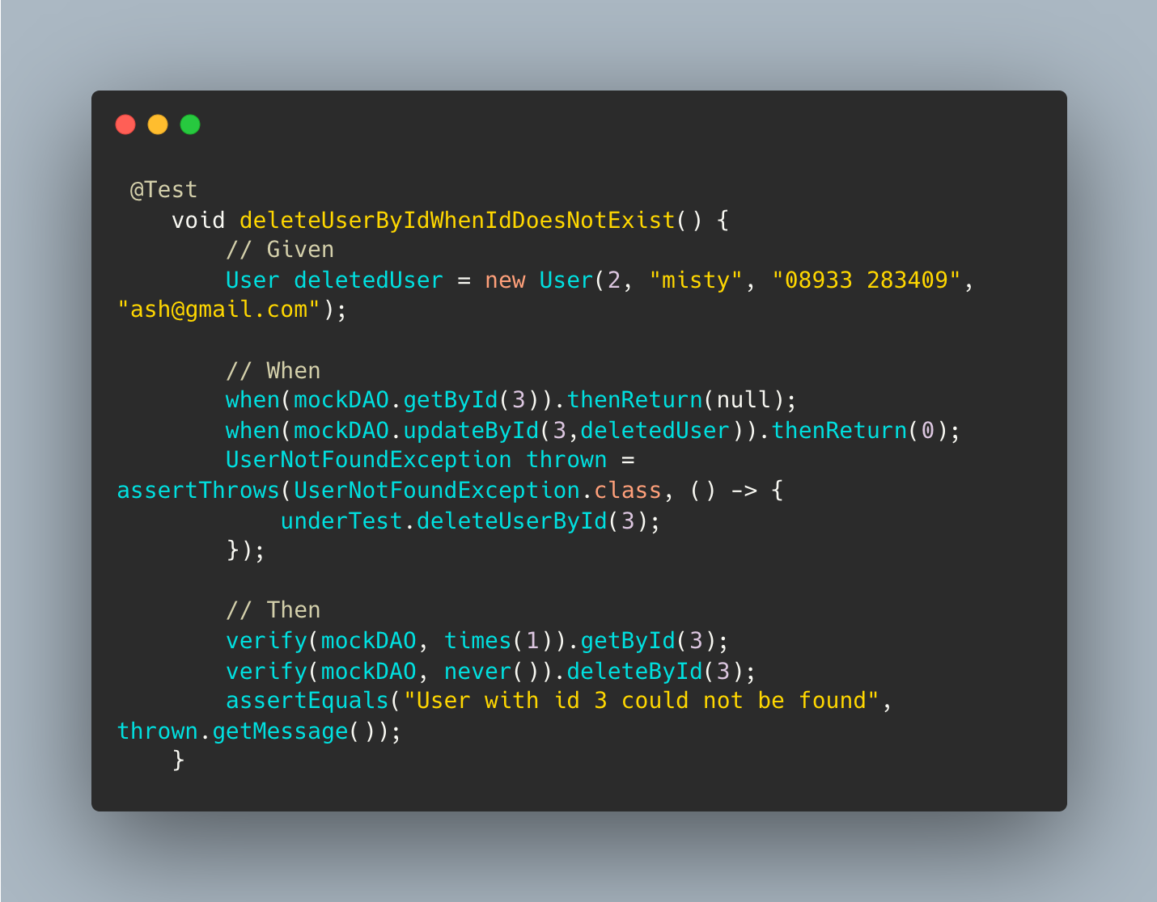
Code snippet
This is a test for deleting a user by their id when their id does not exist. The aim is to make the program throw an exception to make sure it is running smoothly.
Notes:
Adib
This is a test to see if we can delete a user using their ID from the database if that Id does not exist yet. This is a variation of the delete method, deleting user by id, the main aim of this was to see if an exception would be thrown to see if the code was working.
The reason I picked this line of code is due to my uncertainty around testing and mocking prior to this project. With the help of my group I managed to understand it better and write tests myself. Although I am not fully confident in testing, I find myself in a better position than I started this project.

Slide 13
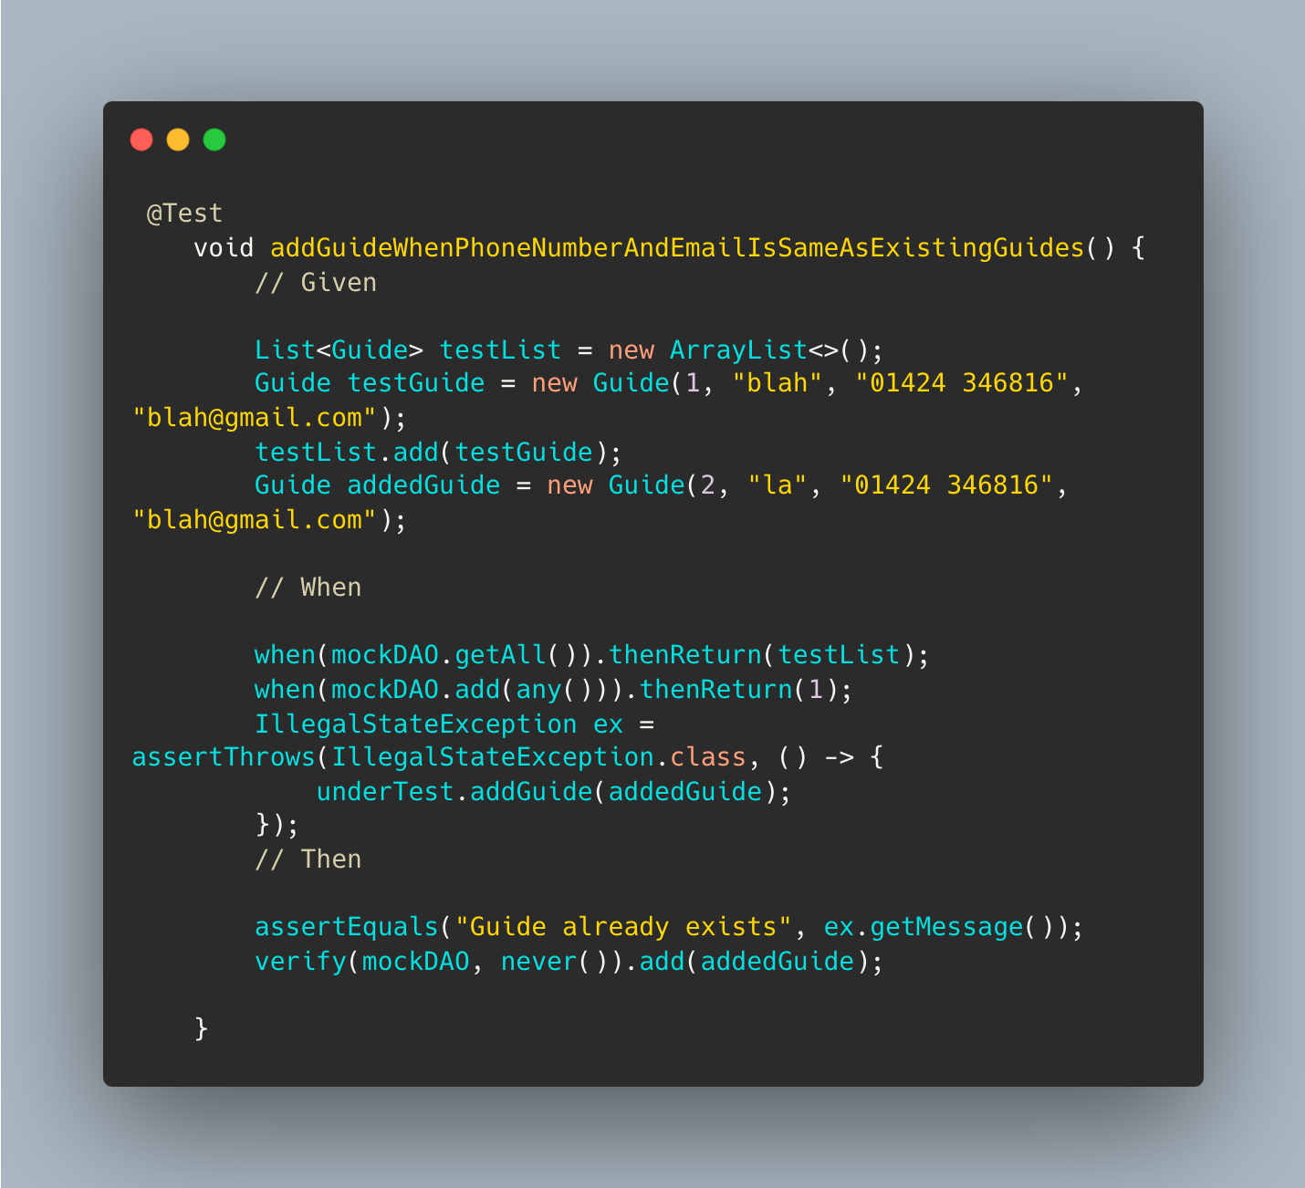
Code snippet
This is a test that when a guide is added who has the same phone number and email as an existing guide. An exception should be thrown indicating this guide already exists.
Notes:
I wanted to talk about this bit of code as i did not have a lot of experiencing with mocking or testing and i had not incorporate an exception being thrown into a test before. So this test the logic in the guide service class that if a guide is added who has the same phone number or email as an existing guide an exception should be thrown informing them this guide exists.
From this I learned about why we need to mock the DAO dependency the service class has to test the code in the service class in isolation and how we need to use a list to act as the database.

Slide 14
Future implementations
Completing our stretch goals e.g.create a user login with security and create search functions.
Perform more tests e.g. testing our database
In users:
if they are already on the activity then they cannot be added again.
The activities they are booked on can be filtered by upcoming and those that have already happened.

Slide 15
Key learning points
Add comments to all our code so when we refer back to it it is clear what we are doing and why.
This will also help other developers understand our code.
Importance of planning, this really helped understand the interactions happening in our code and the database.
Trello to keep track of what everyone is doing.
Time management- we had a set working schedule remembering the importance of balance.
Notes:
Adib
For our key takeaways, we added comments to our code for us to refer back to and for future developer. This made it very easy for us to see what the code is doing and keep on top of our code. as mentioned before, the way we planned and time management was the biggest takeaway for us. Planning really helped us keep on top of our work and manage our time well. Having a set working schedule, helped us make the most of our time and helped us be more productive with less wastage.

